Slide 1
PLT: Week 7
Week 5 Context-setting
Looking at automating Lexical analysis and associated tooling
Notes:
<νυμβερ>

Slide 2
Review
LL(1) parsing:
  Basis:
    Top-down;
    Left-to-Right;
    Strategy for deciding which rule to follow – the predict set, the follow set and the first set.
  Code automation for that;
  A larger example: The RPN generator:
    LL(1) problems:
      Left Recursion
      Common Prefix
    How we sometimes have to change grammars for semantic as well as structural goals
Notes:
<νυμβερ>
Natural Language and abstraction-substitution principle

Slide 3
Solution: Change the Grammar
expr -> term rest
rest -> + term {printf(‘+’)} rest
rest -> - term {printf(‘-’)} rest
rest -> λ
term -> 0 {printf(‘0’)}
….
term -> 9 {printf(‘9’)}
Try:
  9-5+2 to show that the output now works
Then calculate the first set, follow set and predict set

Slide 4
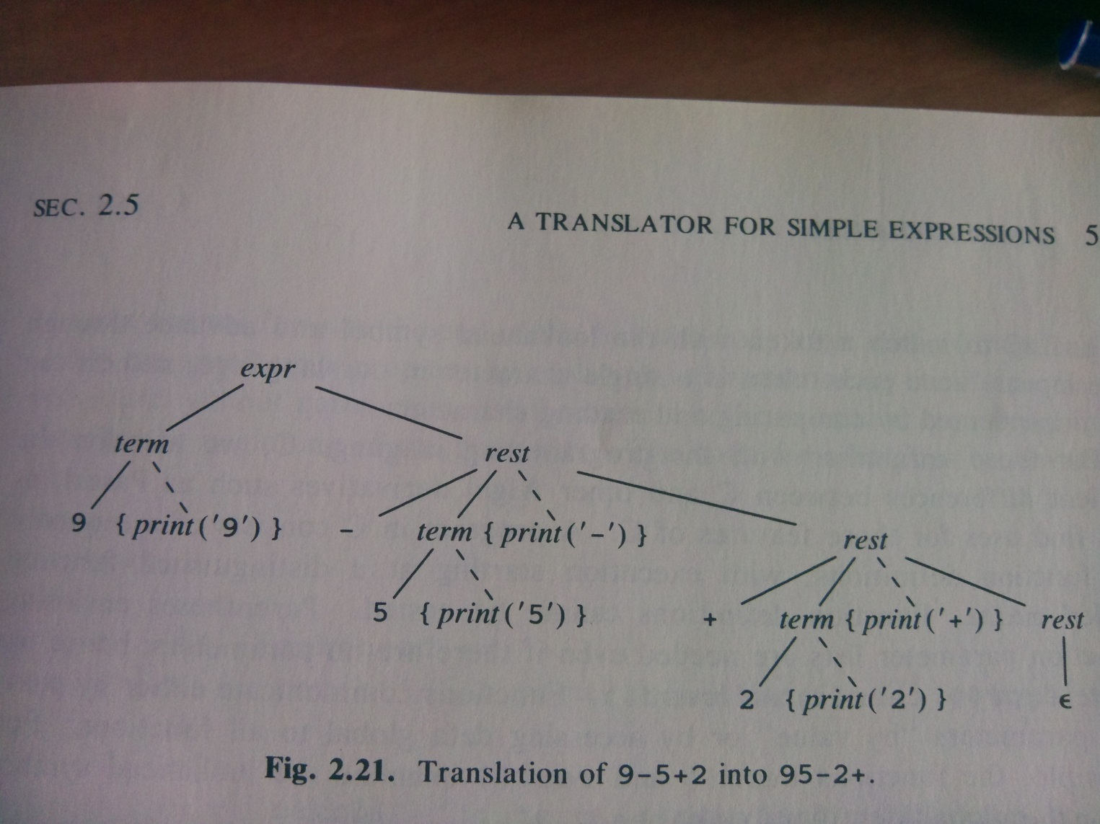
Resultant parse tree:
9-5+2

Slide 5
Suggested Solution with predict sets
expr -> term rest {0-9}
rest -> + term {printf(‘+’)} rest {+}
rest -> - term {printf(‘-’)} rest {-}
rest -> λ {ΕοΙ}
term -> 0 {printf(‘0’)} {0}
….
term -> 9 {printf(‘9’)} {9}

Slide 6
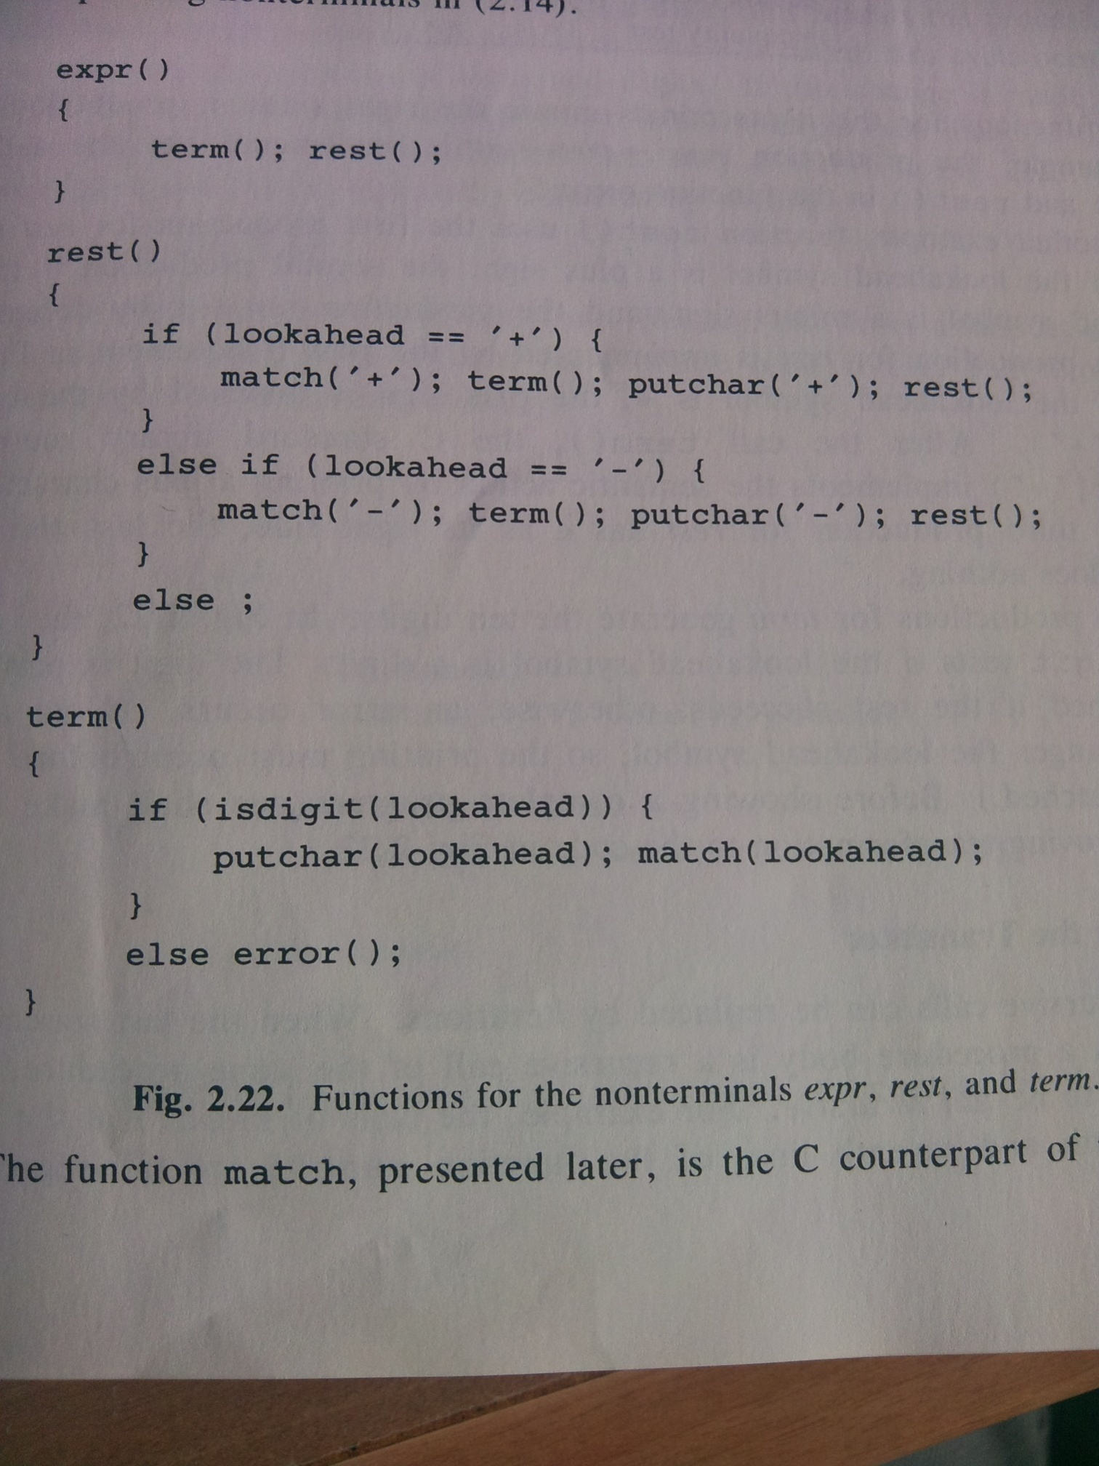
Postfix OP
Postfix OP
Generic handling of Digits
Notes:
Important here to note that what we are doing is execution during traversal of the AST
Here for printout but we can also do that to preserve state
<νυμβερ>

Slide 7
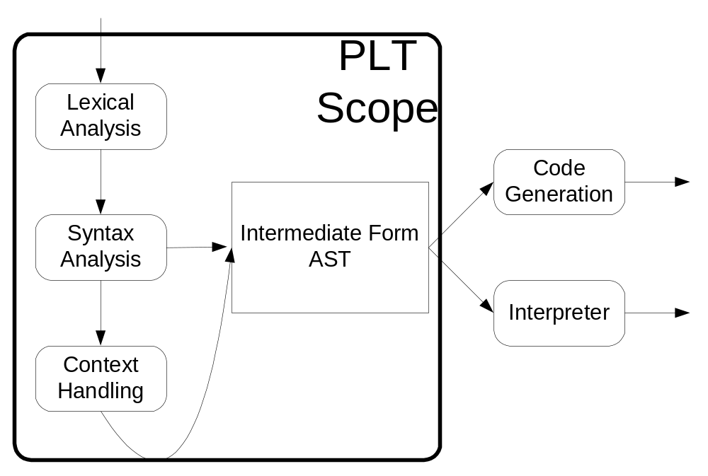
But before syntax there is…
Notes:
Compiler theory also need as an input the VTs and Vts are not always the next character: we need to be able to disambiguate words, identifiers, operators etc – Lexical analysis
<νυμβερ>

Slide 8
Today’s Contents
Lexical Analysis:
  In the RPN example;
  The Symbol table;
  The basis: Regular Expressions;
  Tool support:
    Lex/Flex;
Tool support for syntax analysis:
  YACC/Bison
An examples of an entire solution
The project specification;
Finishing off LL(1) parsing.

Slide 9
Lexical Analysis
Jobs to do:
  Remove white space
  Aggregate strings of numbers into a constant: we will type the resultant lexicons ‘num’
  Recognising keywords
  Recognising identifiers (here referred to as of type ‘id’)
  For each num and id, we need to store their value and name respectively, in a global store;
The parser calls the lexer as it needs new tokens.
Notes:
Ours consumes input (numbers, white space) returning the token and the token value to the caller/parser.
Num is given the value 256 (above any character integer value)
<νυμβερ>

Slide 10
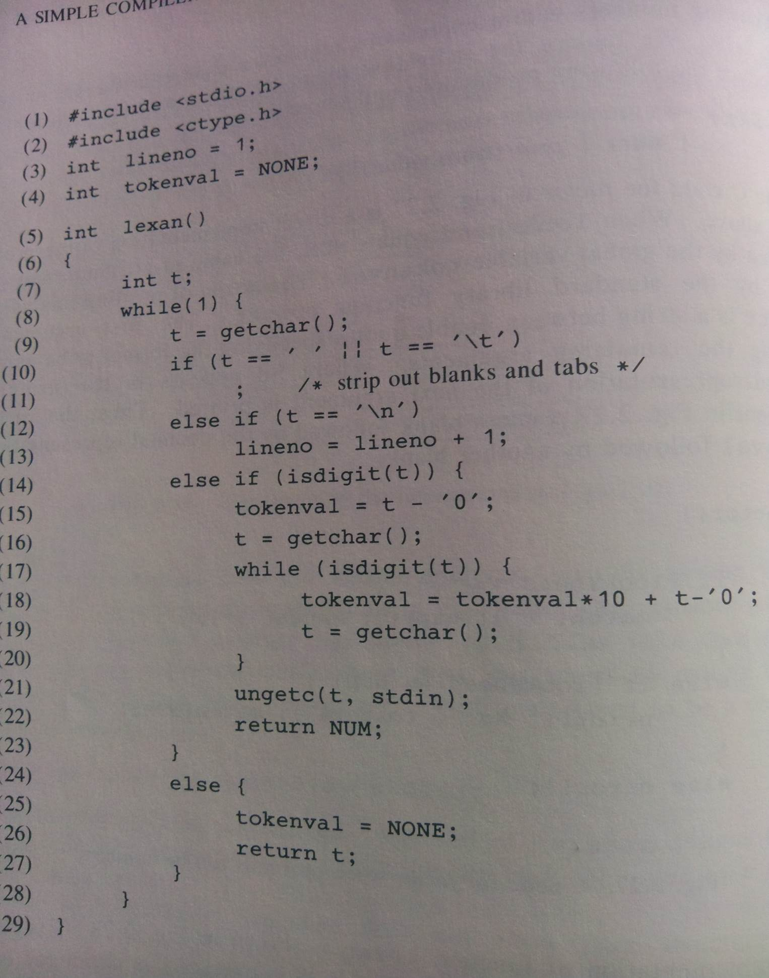
Lexer Code
Notes:
Lexer that ignores spaces/tabs, counts new lines and gathers numbers in tokenval
<νυμβερ>

Slide 11
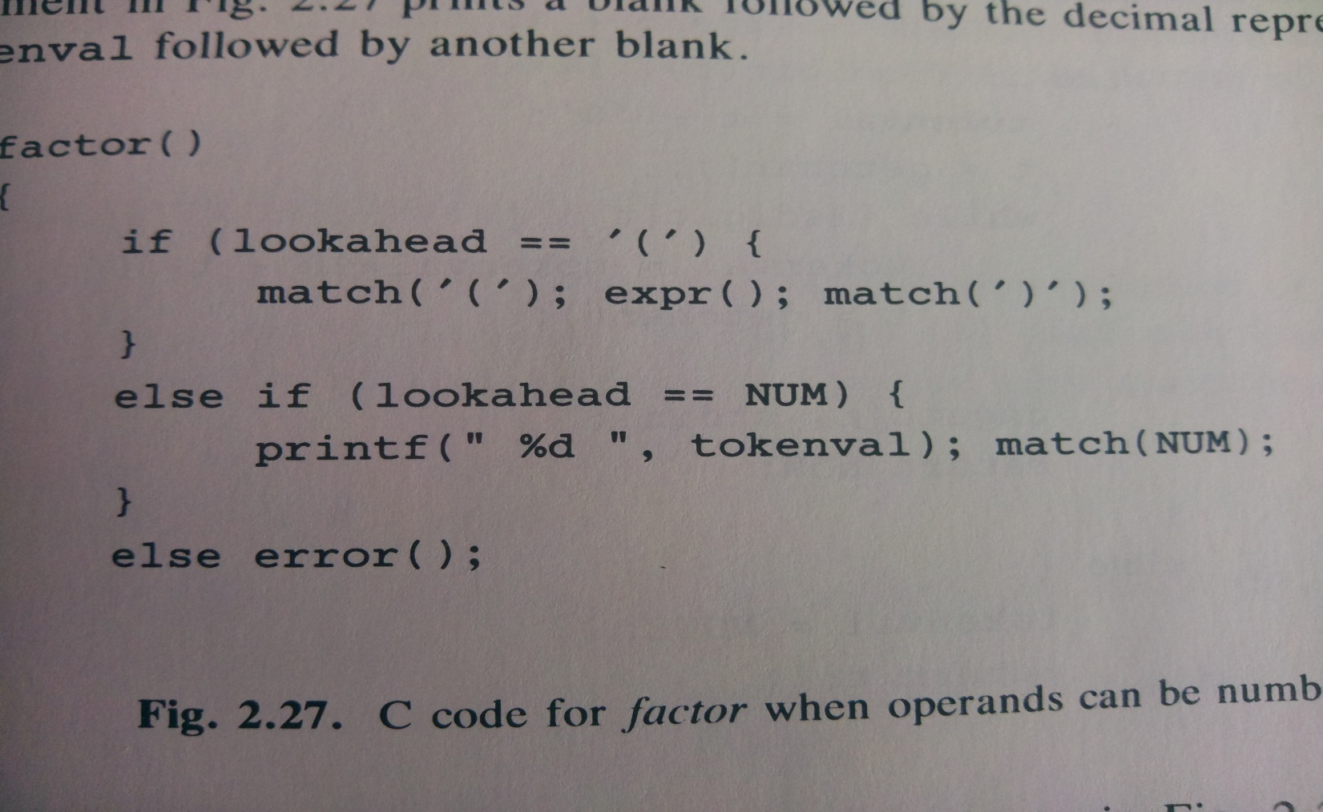
This involves changing the grammar
Individual terms (numbers) now become NUM types with value tokenval:
  term -> NUM {printf(“%d”, tokenval)}
  And an additional rule for ()s:
    term -> ( expr )
Notes:
They call it factor, but its term
<νυμβερ>

Slide 12
The Symbol Table
Often you need to
  Differentiate between a keyword and token
  Repeatedly refer to a token’s value
  Store other attributes (type)
So symbol table:
  Stores reserved words in advance
  Stores new identifiers (their types etc) as it goes
Presumes a:
  Lookup from the table that returns an index to the string
  Insert that inserts tokens and their attributes into the table
The full Lexer looks more like:
Notes:
For example, when a variable is used in a program, you have to check if its declared
For example, its type, its name, whether it refers to data, method, class etc.
<νυμβερ>

Slide 13
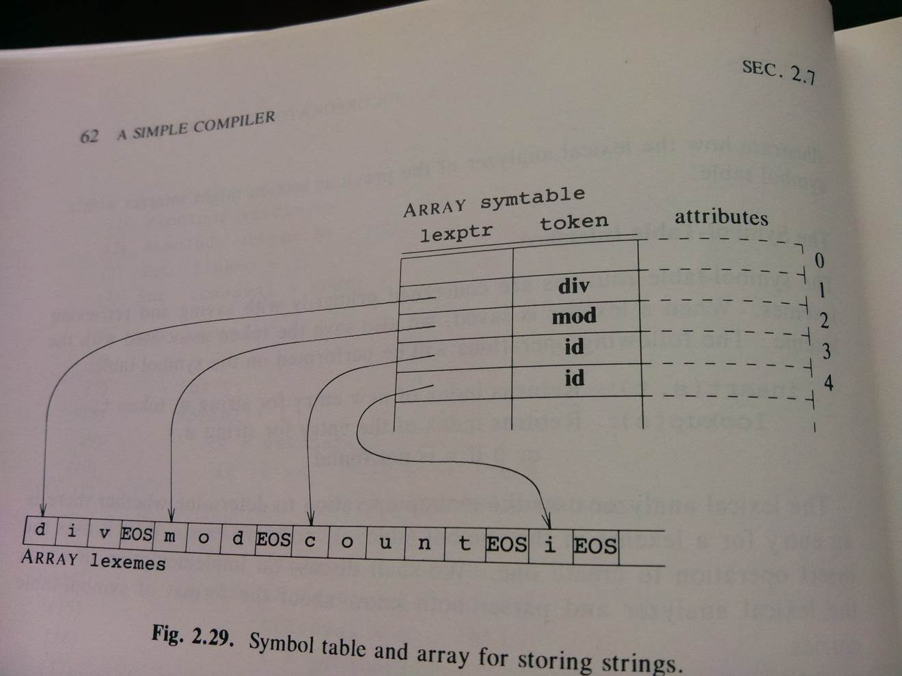
Symbol table

Slide 14
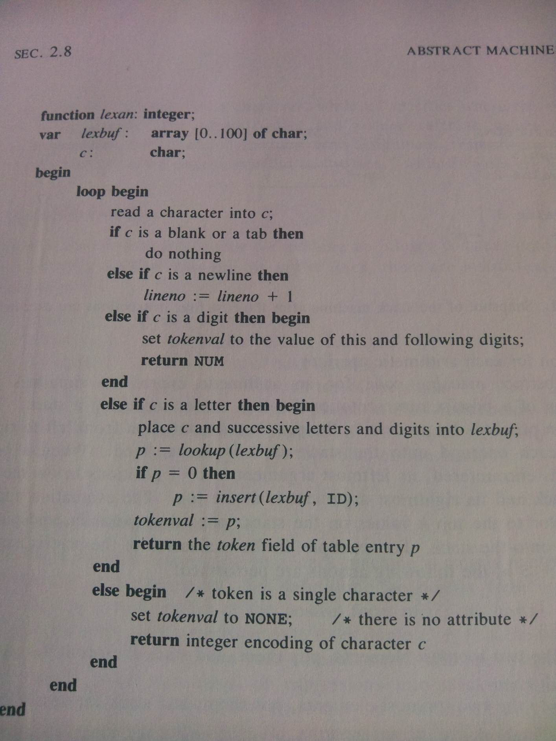

Slide 15
When using Recursive Descent Grammars
The Lexer needs to feed us the next token
  Identifiers;
  Numbers;
  Keywords
  Operations;
  Punctuation
And we looked at Lexer code that would allow us that
… but

Slide 16
The Role of Regular Expressions
Wouldn’t it be better if
  We didn’t have to write all the code.
  Instead we could just specify each type that the parser was interested in…
  and what we wanted to do with it.
  Regular Expression based automatons allow for that approach

Slide 17
Reg. Expressions to specify the tokens
Convenient means of specifying certain simple (though possibly infinite) sets of strings, V_{T}s;
You know them as special text strings for describing a search pattern;
Actually based on Regular Grammars
Basis:
  Strings built from vocabulary via:
    Concatenation; - ‘xyz’
    Alternation: ‘xy87_cz’
    Kleene Closure; Concatenation with a zero-times option: x
Notes:
<νυμβερ>
A regular expression (regex or regexp for short) is a special text string for describing a search pattern. Wildcard for eg.
Based on concatenation, letter concatenate letter concatenate letter
alternation (or) letter concatenate letter or digit
Kleene Closure letter [concatenate letter or digit] 0, 1 or more times

Slide 18
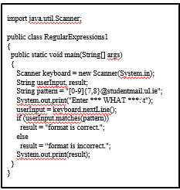
Java Example
Notes:
Student mail
String, case insensitive

Slide 19
Reg Expressions and Tokens
Additional Terms:
  P*
  P+
  Not(A) – Vocabulary-A;
Given:
  D = (0|1|2|….|9) or [0-9]
  L = (A|B|C|…..|Z) or [A-Z]
Number
    ...
Number with decimal point:
    ...
C Line Comment:
    ...
Identifier:
  With no underscores...
  With underscores…
Notes:
<νυμβερ>
Warn them that Flex may give out if faced with these defintions of literals, EOL
L(L|D)* (no underscores)
L(_|L|D)* (with underscores)

Slide 20
Reg Expressions and Tokens
Additional Terms:
  P*
  P+
  Not(A) – Vocabulary-A;
Given:
  D = (0|1|2|….|9) or [0-9]
  L = (A|B|C|…..|Z) or [A-Z]
Number
    D+
Number with decimal point:
    D*.D+
C Line Comment:
    // Not(EOL)* EOL
Identifier:
  With no underscores…L(L|D)*
  With underscores…L(L|D|_)*
Notes:
<νυμβερ>
Warn them that Flex may give out if faced with these defintions of literals, EOL
L(L|D)* (no underscores)
L(_|L|D)* (with underscores)

Slide 21
Wouldn’t it be great if
We could just specify the Reg. Exp.
… And something automated could recognise them:
  Reg Exp ->
  Deterministic FSA ->
  Transducer ->
  Transition Table ->
  Generic code scanning over all transition tables (all regular expressions in the language) to identify the relevant Reg Exp.
Notes:
Do examples v47a3
//stuff1! \n
<νυμβερ>

Slide 22
GENERIC Scanner Code for TT
state = initial_state;
cur_char = getchar();
while (true) {
if (cur_char == EOI) //End Of Input
break;
next_state = T[state][cur_char]
if (next_state == ERROR)
state=next_state;
break;
state = next_state;
cur_char = getchar();
}
if (is_final_state(state))
return (valid_token)
else
return (not_valid_token)
Notes:
Do examples v47a3
//stuff1! \n
<νυμβερ>

Slide 23
Over to you…
Create a:
  Regular expression for dollar currency amounts with a decimal point: $1457.63, $5.15, $1.75, $0.5;
  Transition Table generation, via a Finite State Automata, transducer;
  Generic scanner code that can work over that (any) Transition Table for $5.15

Slide 24
So lets talk about actual tools then
Flex (Lex):
  Token identification through Reg. Exps, transition tables, generic code;
  Called, as-needed by the parser/grammar cruncher;
  The action associated with token recognition is to send it to the parser (Yacc)
Bison (Yacc):
  Grammar cruncher

Slide 25
Flex-Lex Punctuation
* (0,1 or more occurrences of prev. exp)
+ (1 or more occurrences of prev. expression)
? (0 or 1 occurrences of previous expression)
. (any single character except newline char)
[ ] (any character within the brackets):
  [0-9], [a-z], [A-Z], [a-zA-Z]
[^ ] (any character except those within brackets after ‘^’)
{} (how many time prev expression allowed to match):
  [a-z]{1,3}
\ (used to escape meta-characters)
| (or)
“ ” (matches everything in the quotation marks literally)
Notes:
<νυμβερ>
Give them out provisional project spec.

Slide 26
Some Examples: Flex
Literal number:
  [0-9]+
Literal with Optional minus:
  (-)?[0-9]+
Identifier:
Comment:
Matching Quoted Strings where a new line is also considered the end of the string:
Notes:
<νυμβερ>

Slide 27
Some Examples: Flex
Literal:
  [0-9]+
Literal with Optional minus:
  -?[0-9]+
Identifier:
  [a-zA-Z][a-zA-Z0-9]*
Comment:
  \ / \ / .* \n
Matching Quoted Strings where a new line is also considered the end of the string :
  \”[^\”\n]*[\“\n]
Notes:
<νυμβερ>

Slide 28
Minimal Flex Specification
%{
/*
* this sample demonstrates (very) simple recognition: not a verb / a verb (and then only selected ones!)
*/
%}
%%
[\t ]+ /* ignore whitespace */ ;
is |
am |
are |
were |
was |
be { printf("%s: is a verb\n", yytext); }
[a-zA-Z]+ {printf(“%s: is not a verb\n”, yytext); }
.|\n { ECHO; /* normal default anyway*/ }
%%
main()
{
yylex();
}
Notes:
<νυμβερ>

Slide 29
Description
Definition Section:
  Legal C Code;
  For Inclusion into final C program;
Rules Section:
  Rules:
    Reg. Exp. Recognition Rule;
    Action Taken;
    Delimiters;
  Matching Order:
    Only Match Strings Once;
    Longest Possible Match;
    Specification Ordering if match is equal;
User Subroutines Section:
  Legal C Code;
  Again for inclusion;

Slide 30
Getting It Working
Write specification lex file;
  Name it firsteg.l
  flex firsteg.l
  Then compile the resultant C file
Run it:
  first
  Standard input is now analysed:
    The cat is a dog
    The: is not a verb
    cat: is not a verb
    is: is a verb
    a: is not a verb
    dog: is not a verb

Slide 31
Lex Output and Input
Flex The Transducer:
  yytext;
  yyleng;
Input from File:
  yyin;
  yywrap():
    yylex() calls yywrap() on EOF;
    Returns value 1 (no more files)
    Returns 0 (more files):
      Control passed back to yylex();
      Assumes yyin setup with new file;
  Default yywrap(); //dependent on lex or flex
  Overwrite default giving multi-file ability;
Notes:
<νυμβερ>
Reads input from yyin which by default is set to stdin. In re-writing main, we can set it to one of our argv’s
Indeed, if we want to (for example) process a number of files we can use yywrap()
There is a default yywrap() which returns 1 – we could replace it with a yywrap that sets yyin to the next file in the argv list and returns 0.

Slide 32
Lex: (Multi-)File Input
main(argc, argv)
{
if(argc>=1)
{
open first file(argv[1]) and set yyin
to that file;
}
yylex();
//which will call yywrap() on EOF
}
yywrap() {
if check argc = more argv[]s {
set yyin to next argv[]
return 0; }
else
return 1;
}
Notes:
<νυμβερ>

Slide 33
Lex: Intro to Symbol Table
First example listed all words to be recognised as verbs;
Lots of hassle to add new words, and makes lex file very large;
Program language compilers use symbol tables to store words, declared vars etc:
  Table with words and their type
  In this case we want it read in – dynamically:
    noun cat dog mouse;
    verb ate hit chased;
  Function to add-word to table if not there addWord(int type, char *word);
  Function to lookup word int lookUp(char *word);
  Enumerated type for each state/type of word:
    Enum{LOOKUP, VERB, NOUN}
    int state; // reflects type of activity and word: lookup, verb, or noun
Notes:
<νυμβερ>
Where will this happen – Flex declarations section

Slide 34
Lex Rules section
……
%%
\n {state=LOOKUP;}
^verb {state=VERB;}
^noun {state=NOUN;}
[a-zA-Z]+ {
if(state!=LOOKUP)
{addWord(state, yytext);}
else { switch(lookUp(yytext)) {
case VERB: printf(“yytext is verb”); break
case NOUN: printf(“yytext is noun”); break;
default: printf(“Don’t recognise this”); break;
} }
. {/* ignore the rest*/ }
%%
Notes:
<νυμβερ>

Slide 35
YACC: Minimal .y file
%{
/* Limited sentence recogniser */
#include<stdio.h>
%}
%token NOUN VERB ARTICLE
%%
sentence: ARTICLE NOUN VERB ARTICLE NOUN
printf(“Is a valid Sentence!\n”);
%%
extern FILE *yyin;
main()
{
do yyparse();
while(!feof(yyin));
}
yyerror(char *s)
{
fprintf(stderr, “%s\n”, s);
}
Notes:
<νυμβερ>
y.tab.h or name.tab.h generated automatically from this file –Got to here

Slide 36
Description of .y file
Definition Section:
  %{ Literal Code Block %}
  Definitions:
    All TOKENS expected from yylex();
    Any valid C identifier can be used but convention is UPPERCASE;
Rules Section:
  Production Rules;
  Action undertaken;
  Position of Start Symbol;
Code Section:
  main():
    Repeatedly calls yyparse() based on more input;
  yyerror():
    When Impossible to Structure;

Slide 37
Minimal Parser (.l file)
%{
/* this demonstrates (very) simple recognition of a sentence */
#include “y.tab.h” /*token defn.s from the parser*/
%}
%%
[\t ]+ /* ignore whitespace */ ;
“cat” |
“dog” |
“mouse” return(NOUN);
“ate” |
“hit” return(VERB);
“the” |
“a” return(ARTICLE);
[a-zA-Z]+ |
. return(0);
%%
Notes:
<νυμβερ>
y.tab.h or <name>.tab.h depending on release
Contains something like:
#define NOUN 257
#define VERB 258
#define ARTICLE 259
Co-routine point – lex stays at same point in input stream allowing it process from where it left off.

Slide 38
Getting It Working
flex eg2.l (presume lex file is eg2.l)
bison –d eg2.y (presume yacc file is eg2.y)
cc –c lex.yy.c eg2.tab.c
cc –o example lex.yy.o eg2.tab.o –ll
example
<<Type in sentences!>>
Notes:
<νυμβερ>
-d important for tab.h file production.

Slide 39
Less Minimal Parser .y file
%{
/* Limited sentence recogniser */
#include<stdio.h>
%}
%token NOUN VERB ADJECTIVE ARTICLE
%%
sentence: ARTICLE nounphrase VERB ARTICLE nounphrase
{printf(“Is a valid Sentence!\n”);}
nounphrase: NOUN | adjectives NOUN
adjectives: ADJECTIVE | ADJECTIVE adjectives
%%
main()
{ /* as before */
}
yyerror(char *s)
{ /* as before */
}

Slide 40

Get to here

Slide 41
Propagating Values
Every Terminal Symbol has Value:
  NOUN could be ‘cat’, ‘mouse’ or ‘dog’ depending on language instance.
Every V_{N} has a value you can assign to it:
  The C code you enter forms it;
  Expression: NUMBER ‘+’ NUMBER {$$=$1+$3}
        | NUMBER ‘-’ NUMBER {$$=$1-$3}
  This can happen because of default int type;
  Usually not so lucky!:
    Think of previous example;
    Different Symbols: Different Types;
    YYSTYPE: union typedef created by BISON to contain them all;
    YYSTYPE used in y.tab.h for Token Definitions
    Shared Bison/Flex YYSTYPE Var: yylval

Slide 42
Yacc Symbol Types (.y file)
%{
Double vbltable[26];
%}
%union { double dval;
int ival; }
%token <ival> NAME
%token <dval> NUMBER
%type <dval> exp
%%
statement: NAME = exp {vbltable[$1] = $3;}
| exp { printf(“=“%g\n”, $1);}
exp: exp ‘+’ exp {$$ = $1 + $3}
| exp ‘-’ exp {$$ = $1 - $3}
| NUMBER {$$ = $1}
| NAME {$$ = vbltable[$1];}
Notes:
yywrap needs to be defined for this to work now
<νυμβερ>

Slide 43
y.tab.h file Generated
#define NAME 257
#define NUMBER 258
typedef union{
double dval;
int ival;
} YYSTYPE;
Extern YYSTYPE yylval;

Slide 44
.l file associated
%{
#include “y.tab.h”
#include <math.h>
extern double vbltable[26];
%}
%%
[0-9]+|(0-9]*\.[0-9]+) {yylval.dval=atof(yytext);
return NUMBER; }
[ \t] {/* ignore */}
[a-z] {yylval.ival=yytext[0]-’a’;
return NAME; }
etc….

Slide 45
P4 Assessment (30%)
Project Specification
Parsing a small language called BUCOL
Using:
  Lex/Flex to identify the individual tokens/ lexicons
  Yacc/Bison to check on its structure
Report on its correct formed-ness
Report on specific errors
Spec tomorrow
Phased hand-in weeks 9, 12

Slide 46
Finishing Automated LL(1) Parsing
Language Instance:
  t-g[tg-tpr
Grammar:
  S-> E
  E -> Q [ E r
  E -> t H
  Q -> g
  H -> - E
  H -> Q H p
  H -> λ
Notes:
<νυμβερ>
We have shown how, for a given grammar and predict set we can generate code to parse that language instance
The user specifies the grammar, but wouldn’t it be nice if the computer could calculate the predict set
It can… give me the rules…

Slide 47
Automation for predict set
If V_{N}-> V_{T}... Then
  Predict set ={V_{T}}
If V_{N}-> λ... Then
  Predict set ={Follow (V_{N}) on RHS of rules
If V_{N}-> V_{N}... Then
  Predict set ={union of predict sets for all rules with V_{N} on LHS}
  } recursively
If V_{N}-> V_{N1}... Then
  Predict set ={find every rule with V_{N1} on LHS and find its predict set, using these rules recursively}

Slide 48
Sample LL(1) Parse
Language Instance:
  t-g[tg-tpr
  tgp (for code run through)
Grammar:
  S-> E {g, t}
  E -> Q [ E r {g}
  E -> t H {t}
  Q -> g {g}
  H -> - E {-}
  H -> Q H p {g}
  H -> λ{p, r, EOI}
Notes:
Use the rules to calculate the predict set…
<νυμβερ>

Slide 49
LL(1) Table for EG.
\ V_{T} V_{N} | t | - | g | [ | p | r
S | 1 |  | 1
E | 3 |  | 2
Q |  |  | 4
H |  | 5 | 6 |  | 7 | 7
Notes:
<νυμβερ>
Can translate this into an LL(1) table – for each VN it identifies the production rule to use when faced with the the next VT on the input stream

Slide 50
Then we can make the C code generic
The predict set can give us an LL(1) table per grammar
And we can have generic code that works over that LL(1) table:
  Where there is only 1 procedure, covering all non terminals
  The specialist ‘case statements’ are exported to the LL(1) table
  See how this is now truly generic

Slide 51
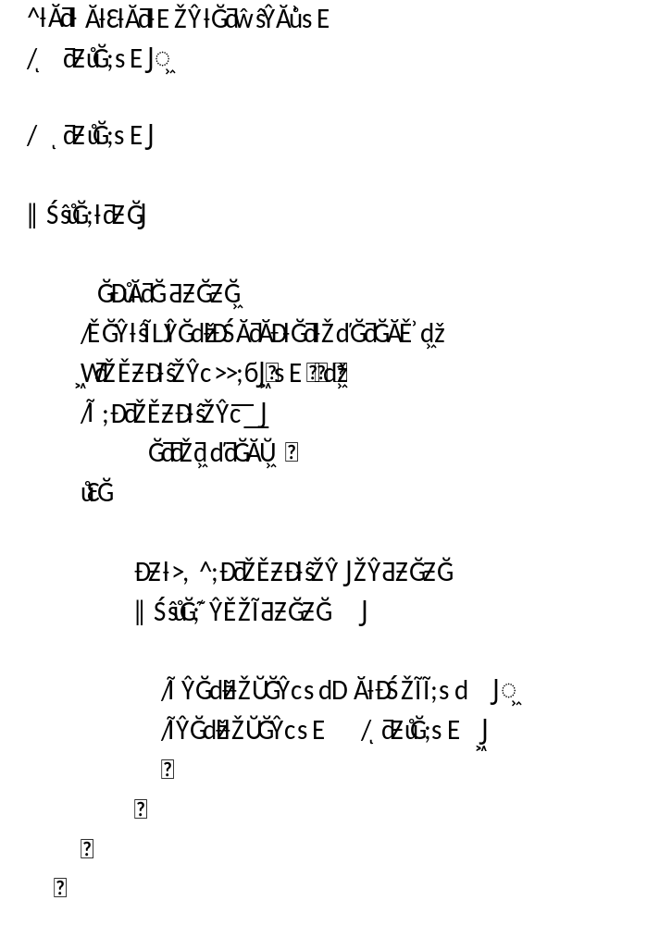
Notes:
Highly similar to recursive descent code we wrote earlier but with only 1 procedure for all Vn and case statements “exported” to external table
<νυμβερ>

Slide 52
LL(1) Table: Your turn to create an LL(1) look-ahead table
F->Zj-rJHp
Z->aY
Z->λ
J->ZP
J->w
P->q
P->λ
H->t
H-> λ

Slide 53
Your turn (Answer)
F->Zj-rJHp {a,j}
Z->aY {a}
Z->λ {j,q,t,p}
J->ZP {a,q,t,p}
J->w {w}
P->q {q}
P->λ{t,p}
H->t {t}
H-> λ {p}
Now manually run through: j-rwp

